Slide 1
Bradford Safeguarding Adults Board Annual Report
2018 - 2019

Slide 2
Table of Contents
Page
Introduction 3
Executive Summary 4
Plan on a page 5
What is the Safeguarding Adults Board? 6
Bradford Safeguarding Adults Board (BSAB) structure 7-8
Strategic Statement 9
Key Priorities 10-11
BSAB – Board activity 12
Data Summary 13-16
Learning and Improvement 17-19
Making Safeguarding Personal (MSP) 20
The Safeguarding Voice Group 21
Performance Quality and Assurance Group and Safeguarding Adult Reviews 22
Collaboration with other Strategic Boards 23
Communication and Engagement 24
Partners Key Achievements 25-29
Future and Conclusion 30
How to report a concern 31
Abbreviation Matrix 32

Slide 3
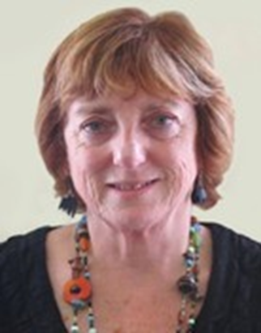
Introduction from the Independent Chair of the Board – Jane Geraghty
It gives me great pleasure to present Bradford Safeguarding Adults Board (BSAB) annual report for the period 2018-2019. I became the independent chair in June 2018 and I have worked relentlessly to continue to drive forward the Board priorities as indicated by you the people of Bradford that the Board remains accountable to.
We have achieved great things over this relatively short time, we had a hugely successful safeguarding engagement event in June 2018 that was attended by over 100 people including adults who use services, their carers and lead representatives from partners who sit on the Safeguarding Board.
This event was a real success to highlight what the safeguarding priorities are in Bradford and was testament to how user groups are fantastic at engaging people in Bradford and willing to support them to understand about safeguarding and what that means including how people can access support and ensure their voices are heard.
This event reinforced how the principles of working together in partnership created a shared understanding and real commitment to making a difference to the lives of adults who may experience or witness abuse.
I would also like to thank all the people, professionals and partner organisations for the progress of the Board’s priorities over this annual report period and for their patience whilst the reconfiguration of the Board’s Business Unit was progressed. This has resulted in the combining of the Adult Board Business Unit with the Children’s Board, enabling a closer working relationship between the two and more consistency in how we work together. I hope this will instil confidence that the Board continues to move in the right direction as a key partnership so that Bradford as a community continues to promote and ensure the health, wellbeing and safety of adults with care and support needs across the district.
Jane Geraghty
Independent chair
Jane Geraghty
Independent SAB chair

Slide 4
Executive Summary
Bradford continues to be enriched by its diversity and the Bradford Safeguarding Adults Board (BSAB) continues to work together with partner organisations and people in our communities so that Adults can live the best lives they can with their wellbeing and rights being supported, safe from abuse and neglect. Through the year the BSAB continued to work against the 3 priorities
Make safeguarding personal and support adults at risk to achieve the outcomes they want
Making sure that all services have the appropriate systems and processes in place to support and safeguard adults effectively.
Partners, organisations and communities work together to prevent abuse from happening
The Business Units for the Childrens Safeguarding Board and BSAB are now combined as a single Unit which has improved the synergy between the two partnerships and allows a greater consistency of approach, efficiencies of working and sharing of good practice.
Bradford Council’s Safeguarding Adult Team received 6% fewer concerns and there was a large decrease in the number of these that met the Section 42 criteria from the previous year. Approximately half of concerns relate to people aged 65+ and about a 33% relate to physical abuse. Approximately 20% (of what) relates to people that had a primary support need of a more complex nature.
Single and multi-agency training programmes have been reviewed and updated in response to local procedural changes and to embed Making Safeguarding Personal (MSP). The Training sub-group has maintained close working links with the Safeguarding Voice group to ensure service users have the opportunity to influence and comment on training and resources used. The seventh Annual Safeguarding Week was a resounding success with over 60 events.
The Safeguarding Voice Group continues to support the work of the BSAB and in particular around MSP. The group worked on various projects and assisted in the Mate Crime launch and also the public engagement event held in June 2018 . This was a successful community engagement event, hosted by the BSAB, and considered the new BSAB plan, which explains how the BSAB will work in the future to keep people safe. The event was aimed at people who use services, support workers and carers, local community groups and members of the public, with over 100 people at the event providing feedback on the new plan.
Partners and service users contributed to Making Safeguarding Personal and completed work on materials explaining ‘What is Making Safeguarding Personal all about', and also a toolkit of MSP exercises that trainers can use to help everyone understand MSP.
Partners decided that 2 cases met the criteria under Section 44 of the Care Act where a Safeguarding Adult Review would be undertaken. The BSAB formed a dedicated SAR sub-group and updated the Safeguarding Adults Review toolkit.
Bradford continues to develop collaborative work with other Strategic Boards and amongst the sub-groups. The Risk and Vulnerabilities sub-group now includes all complex safeguarding themes, linking with the West Yorkshire group. The Communications and Engagement group continues to increase its membership and influence and expertise to raise awareness and support for professionals and communities.

Slide 5
Plan on a Page

Slide 6
What is the Safeguarding Adults Board?
Who we are
The Safeguarding Adults Board (SAB) is a multi-agency partnership which has statutory functions under the Care Act 2014. The main focus of the SAB, is to ensure that in the Bradford District safeguarding arrangements work effectively so that Adults at risk are able to live their lives free from abuse or neglect.
An Adult at risk is a person aged 18 or over who has needs for care and support and as a result of those needs is unable to protect themselves from either the risk of, or the experience of abuse or neglect. Unpaid carers such as partners, relatives or friends can also get help and support if they are being abused.
What is adult abuse?
Abuse is when someone does or says things to another person to hurt, upset or make them frightened. There are many different types of abuse, more details can be found on our website: www.saferbradford.co.uk
Whose responsibility is it?
Safeguarding is everybody’s responsibility, for example: members of the public, friends, neighbours, staff and carers.

Slide 7
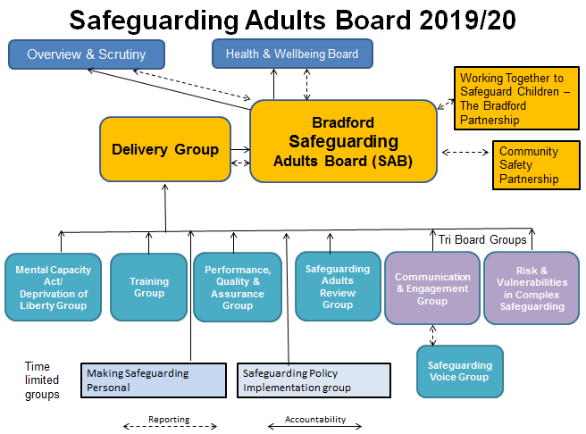
Board Structure

Slide 8
Board Structure
Membership to our Board includes:
Independent Chair
City of Bradford Metropolitan District Council
West Yorkshire Police
Yorkshire Ambulance Service NHS Trust
West Yorkshire Fire and Rescue Service
Bradford District, Bradford City and Airedale, Wharfedale and Craven CCGs
Airedale NHS Foundation Trust
Hanover Housing
Healthwatch
Equality Together
Bradford People First
West Yorkshire Community Rehabilitation Company
National Probation Service
Incommunities
Bradford Teaching Hospitals NHS Foundation Trust Independent Sector
Bradford District Care NHS Foundation Trust
NHS England
Alzheimers Society
Choice Advocacy
Expenditure & Funding:
Staffing - £182,050 & Other £600 – Total - £182,650
Funded by:
CCG’s - £57,700
Police - £17,700
Local Authority budget £ 107,250

Slide 9
Strategic Statement
Our Strategic Statement
We will work together with partner organisations and people in our communities so that Adults can live the best lives they can with their wellbeing and rights being supported, safe from abuse and neglect.
Our vision Is to promote happiness by working together to help people feel safe - free from abuse and neglect
Our mission Is to put the wellbeing and safety of adult at risk of abuse at the heart of everything we do

Slide 10
The Care Act 2014 asks all Safeguarding Boards and its partners to follow the following six key Safeguarding Principles:
Key Priorities

Slide 11
Key Priorities
Make safeguarding personal and support adults at risk to achieve the outcomes they want
Making sure that all services have the appropriate systems and processes in place to support and safeguard Adults effectively. This means that we will protect Adults who have been abused and make sure safeguarding works well
Partners, organisations and communities work together to prevent abuse from happening - This means everyone will be able to recognise what abuse is and know how to respond

Slide 12
Bradford Safeguarding Adults Board (BSAB)
The BSAB has continued to oversee the partnership response to safeguarding, through quarterly meetings, development sessions and strategic planning days. The Board focussed upon;
Exploring behaviours and expectations of a learning board
Confirm/amend the priorities for the coming year
Gain assurance that emerging themes are addressed
Review the performance management framework
Bradford continues to maximise learning with regional partners and contributed to easy to get to formats for Safeguarding Policy and Procedures, developing performance frameworks and exploring the Section 42 duty of the Care Act (2014) to undertake safeguarding enquiries.
The Business Units for the Working Together to Safeguard Children – The Bradford Partnerhsip and the BSAB are now combined into a single unit. This allows a greater consistency of approach, effectiveness, sharing of good practice and provides increased resilience across the Business Unit. This is now known as the Bradford Safeguarding Partnership Business Team.

Slide 13
Data Summary
534,800
People live in Bradford
There has been a population increase of 2,300 people in the last year
64% Identify as White British
The district has the largest proportion of people of Pakistani ethnic origin (20%) in England
51%
Women
49%
Men

Slide 14
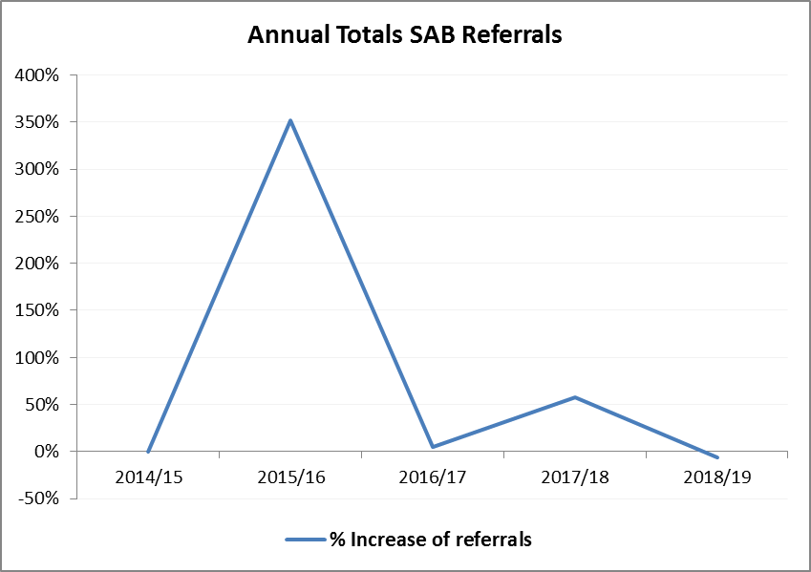
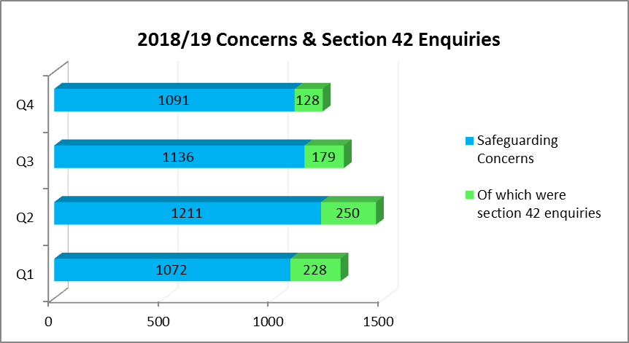
Data Summary
4,510
6%
Concerns raised
in 2018/19
Decrease from previous year
Bradford Council’s Safeguarding Team received 4,510 Concerns during 2018-19 which decreased by 6% from 4,815 in 2017-18
785 of the concerns (17%) met the Section 42 criteria, a large decrease from 2,925 the previous year
The average increase in referrals during 2018/19 was 18%, we would expect to see the number of referrals fluctuate due to increased awareness and embedding of processes
Further exploration of this trend is underway to provide a full explanation.
The following factors should be taken into account;
How the data is recorded
The responses from the MASH
A more experienced and trained workforce
How the information is screened
Statutory functions of the Care Act
Interpretations of section 42 and at what stage this is undertaken

Slide 15
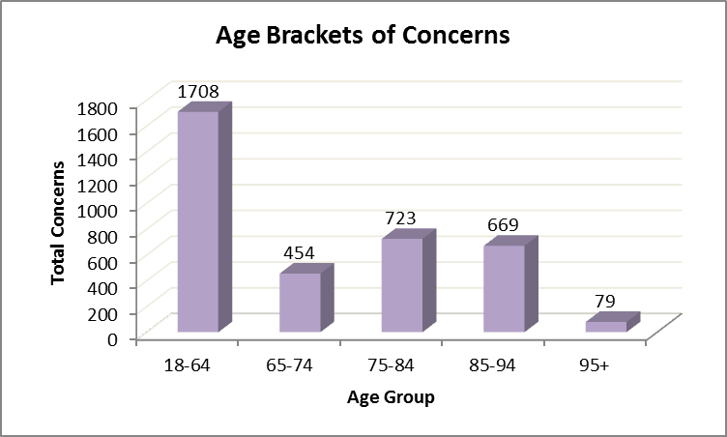
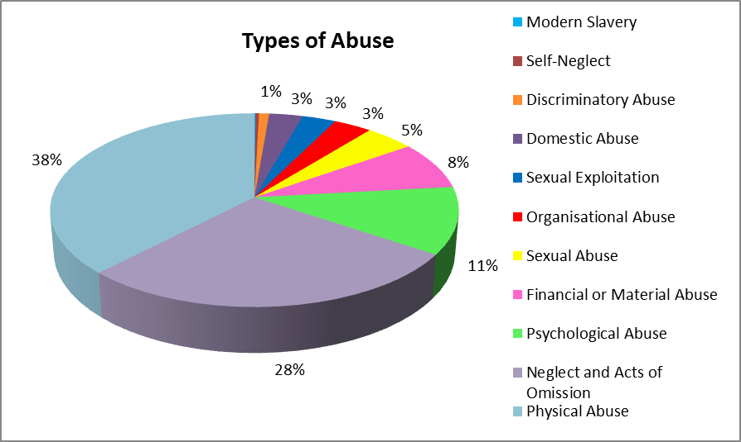
Data Summary
53%
Of Concerns relate to people aged 65+
38%
Of Concerns relate to physical abuse

Slide 16
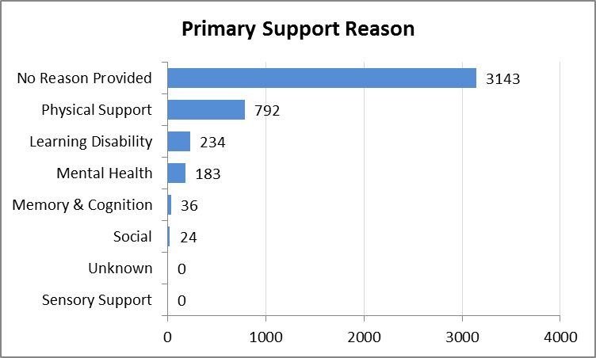
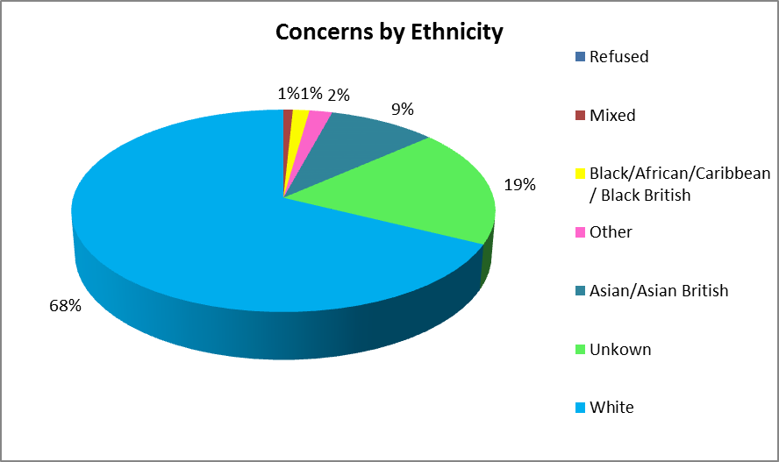
Data Summary
18%
Relates to people that had primary support need - this is the main reason why someone needs social care and support.
Relates to people who self identify their ethnicity as white, followed by 9% Asian/Asian British. In relation the 2011 Census, we would expect to see a larger portion of people of white ethnicity as the population of Bradford consists of 64% people of white ethnicity and 25% Asian/Asian British. The 19% unknown relates to recording processes and is being addressed.
68%

Slide 17
Learning and Improvement
Multi-agency training programmes have been updated to reflect ‘Making Safeguarding Personal’, as part of our preparation for new Multiagency Safeguarding Adults Procedures.
The Training sub-group also looked at new information about learning from other authorities and lessons learned from SAR’s.
The Training sub-group has maintained close working links with the Safeguarding Voice group, to ensure service users have the opportunity to influence and comment on training and resources used. ‘Real Safeguarding Stories’ continue to be used as an invaluable learning resource. https://realsafeguardingstories.com/
Multi-Agency safeguarding adult training courses delivered in 2018-2019:
Recognising and Responding to Abuse
Role of the Service Manager
Training for Trainers
Partners have also provided assurance that their workforce are able to access Mental Capacity Act training and audits provide the assurance of legal compliance with the Act
A number of Making Safeguarding Personal sessions have been run this year with participants from user groups and staff.

Slide 18
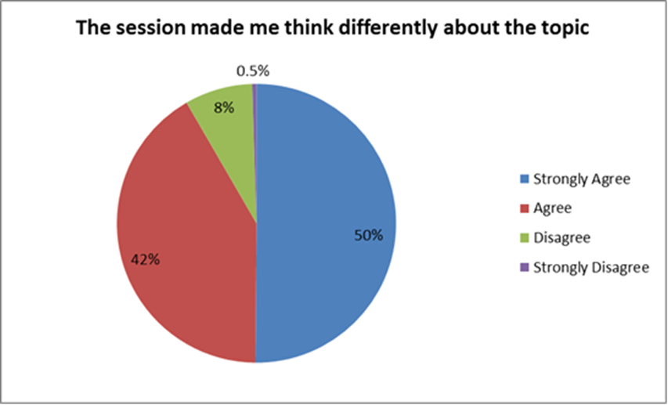
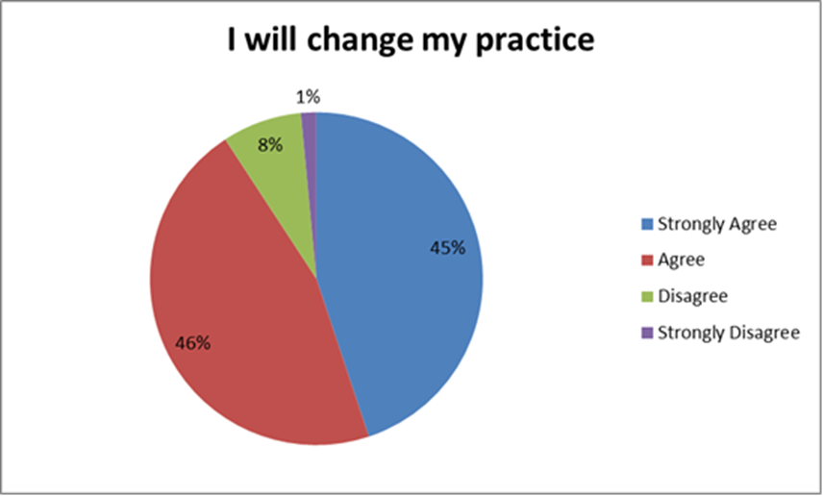
Learning and Improvement - Feedback
A standard evaluation form is used by event organisers to collate and summarise participants feedback effectively. The feedback was extremely positive, highlighting that 92% felt that the session had made them think differently about safeguarding adults.
Feedback also highlighted that 91% of practitioners reported that they would change their practice following attendance.
Going forward together - Community Engagement Event update
On Wednesday, 27 June 2018 the BSAB hosted a community engagement event on its new plan, held at Manningham Mills. The new 3 year plan explains how the Safeguarding Adults Board will work in the future to keep people safe from abuse and neglect.
The event was aimed at people who use services, support workers and carers, local community groups and members of the public. The BSAB was delighted to welcome over 100 people throughout the day, who came to give some feedback on what they thought about the new plan.
Here are some short films on how the day went: https://www.bradford.gov.uk/adult-social-care/adult-abuse/community-engagement-event-update/

Slide 19
Safeguarding Week
Bradford continued in its traditions of delivering a comprehensive and innovative training offer during Safeguarding week. This brings together numerous partners as well as all three Strategic Boards – the BSAB, Community Safety partnership and the Childrens Safeguarding arrangements (now called Working Together to Safeguarding Children – The Bradford Partnership. This year was the seventh annual multi-agency Safeguarding Week. “Safeguarding - It’s Everybody’s Business” and was once again the focus of a fantastic range of opportunities for learning and development. There were 60 organised events hosted across the District for professionals and 2 City Centre events for the public. There were a range of types of events from conferences with 100 plus people attending to interactive workshops of 15-20 people.
The local input highlighted the ways in which practitioners and members of the community are going the extra mile in their safeguarding practice.
A few highlights:
Inputs included the Care Act, Mental Capacity Act, Domestic Abuse and Modern Day Slavery.
Airedale Annual Conference on Complex safeguarding, county lines, forced marriage, cyber crime
Financial Abuse with input from the Gambling project at Citizens Advice Bureau
BTHFT conference Coercive Control featuring the Bright sky app with one comment being “Bright Sky – Wow”!
Sharing Voices with a local school providing healthy relationship workshops to 300 pupils in one day!
Launch of two new Real Safeguarding Stories on County Lines and Hate Crime with the support of Bradford Future Leaders, with hot seating actors / participants interaction
Safeguarding Stall in Broadway Shopping centre hosted by Bradford People First

Slide 20
Making Safeguarding Personal
A Making Safeguarding Personal (MSP) time limited group was set up in autumn 2018, of key partners including representatives from people who use services. The group is progressing work against an action plan and have completed work on materials explaining ‘What is Making Safeguarding Personal all about’ which will be used in policies and publicity to raise awareness about MSP, and also a toolkit of MSP exercises that trainers can use to help everyone understand how to make safeguarding personal. Adult Social Care have been working as part of the group to make sure that a new IT system can record information about MSP, including what outcomes people want and what help they need to be protected from abuse or neglect.

Slide 21
The Safeguarding Voice Group
This group continues to support the work of the BSAB and in particular around MSP. The group have completed a safeguarding evaluation questionnaire in collaboration with Adults at risk, families, and professionals within the partnership and also undertook extensive work to coordinate the BSAB’s public engagement event held in June 2018 and to facilitate the Mate Crime Launch in Bradford. The members worked on updating the Safeguarding Bingo pack and learnt about the Healthwatch, MCA & Safeguarding, were able to influence safety issues with housing support services to put things right. The group worked with University of Nottingham’s research ‘My Marriage My Choice’. This research is based on forced marriage of people with learning disabilities and this ensured that the people in Bradford were heard in this national project. The group also supported a voice member who is an author with ideas/case studies for his book research. Finally, they finalised a framework for Making Safeguarding Personal outcomes.
“I have sat on the Safeguarding Adults board now for a number of years and there has been some great development work over these years. We are really proud that we were invited to the Local Government Association to talk about the user involvement at BSAB and hopefully this influenced involvement of service users at other boards around the country.
Not many Board have users voice sat at the Board like we do in Bradford, this is a really pioneering approach that needs to be embraced elsewhere. The voice group have done lots of work over the year and we look forward to advising and supporting the board to achieve ever great things this coming year to ensure adults at risk in Bradford get the support they need to live the life they chose.
I would also like to see other ways that partners can come together to highlight issues and find ways of working together to find solutions that are meaningful to adults at risk in Bradford, other than a formal Board meeting.”

Slide 22
Performance Quality and Assurance Group (PQAG)
This group established the key content of the performance dashboard that will provide information and assurance to the BSAB.
The information provided in the performance dashboard will drive positive changes in service delivery.
The scope of annual audits and self assessments are agreed within this group, these provide assurance and highlight key trends to the BSAB.
Safeguarding Adult Reviews (SARs)
The SAR sub-group works closely with all other sub-groups to ensure that learning from reviews is acted upon, through training, communications and also how audit and inspection can provide assurance that practice has improved.
Partners scoped and considered a number of safeguarding cases to consider if they met the criteria under Section 44 of the Care Act. Two cases fell within this criteria and the BSAB decided that Reviews would be undertaken. Partners also reviewed and updated the Safeguarding Adults Review toolkit. The BSAB also restructured and developed a dedicated SAR Group to maintain oversight and coordinate all SAR activity.
A Local authority representative became involved in Social Care Institute for Excellence (SCIE) as a Safeguarding Adult Review champion for Bradford, and the information gained has informed the SAR practice in Bradford.

Slide 23
Collaborative arrangements with the Bradford Partnership and Community Safety partners.
Bradford has continued to recognise opportunities to improve how we work with other strategic groups namely the Working Together to Safeguard Children - the Bradford Partnership (TBP), the Community Safety Partnership (CSP). This approach will ensure that cross-cutting areas of work are identified and progressed collectively thereby achieving the best outcomes for people of all ages across the District, avoiding duplication of effort where a co-ordinated response is more appropriate. Across these three partnerships, we will develop opportunities for a more consistent and combined approach that presents opportunities for shared learning.
Over a number of years Bradford has benefited from an established and experienced Child Sexual Exploitation and Missing Sub-Group. The group has now extended its focus to coordinate activity around a number of themes, in raising awareness and understanding. The group includes representation from a number of partners and coordinates activity across the across TBP, the BSAB and the CSP. The group has now extended its remit to include vulnerable adults and to coordinate activity around a number of emerging themes, in raising awareness and understanding. The group is now known as Risk and Vulnerabilities in Complex Safeguarding. The group has developed a Strategic Response.
This strategy has 6 headings:
1. Identify and understand the nature and scale of the themes involved 4. Effective leadership and governance
2. Prevention, Education and Awareness 5. Disrupt and Prosecute
3. Safeguarding vulnerable people, groups and communities 6. Communication, Engagement and Empowerment

Slide 24
Communication and Engagement
Building upon the excellent work in the past by the BSAB there is now a Communications and Engagement Group that includes representation from the CCP and TBP. This group is a mix of safeguarding experts as well as media experts, including a member of the Voice Group, representation from the Voluntary and Community Sector and also a Social Media apprentice. The aims of the group are to provide practitioners, parents, carers’ children and communities with proactive, innovative and consistent approach to communications and the group have developed a communication strategy to support these aims. The BSAB continues to communicate through a variety of mediums including Twitter and other social media platforms but also recognises that other mediums are necessary for other demographical groups. The ethos of the group is to allow communication both ways, from the safeguarding partners but also to engage in a way that captures the voice of the child and adult.
The BSAB held a successful safeguarding conference in June 2018 that included raising awareness of safeguarding by showing a real safeguarding story, the event also focused on supporting people to understand what safeguarding means to them and reflecting and developing the key priorities for the Board.
The BSAB held a development day with key partners to ensure a collaborative approach and shared vision and priorities. They also conducted an on line consultation and held a public engagement event to ensure adults with care and support
needs and their carers had a say in what they believe were the key
priorities for the Board. The consultation received over 250 responses from
people, professionals and organisations.

Slide 25
Partners Key Achievements In 2018-2019
How does the Care Quality Commission (CQC) link with Bradford Safeguarding Adults Board and safeguarding partners?
Safeguarding is a key priority for CQC and people who use services are at the heart of the Care Quality Commission. CQC falls under the Health and Social Care Act 2008 to have regard to the need to protect and promote the rights of people who use health and social care services.
CQC’s role in safeguarding is:
• Checking that care providers have effective systems and processes to help keep adults safe from abuse and neglect.
• Receive information about safeguarding to assess risks to adults and children using services, to make sure the right people act at the right time to help keep them safe and to inform our inspections.
• Acting promptly on safeguarding issues we discover during inspections, raising them with the provider and, if necessary, referring safeguarding issues to the local authority – who have the local legal responsibility for safeguarding – and the police, where appropriate, to make sure action is taken to keep children and adults safe.
• Speaking with people using services, their carers and families as a key part of our inspections so we can understand what their experience of care is like and to identify any safeguarding issues. We also speak with staff and managers in care services to understand what they do to keep people safe.
• Holding providers to account by taking regulatory action to ensure that they rectify any shortfalls in their arrangements to safeguard children and adults, and that that they maintain improvements. This includes requiring providers to produce action plans, taking enforcement action to remedy breaches of fundamental standards, and taking action against unregistered providers.
• Publishing our findings about safeguarding in our inspection reports, and awarding services a rating within our key question ‘Is the service safe?’ which reflects our findings about safeguarding, safety and quality of the care provided.
• Supporting the Police and local authority’s lead role in conducting enquiries or investigations regarding safeguarding children and adults. This includes sharing information where appropriate from our regulatory and monitoring activity.
• Explaining our role in safeguarding to the public, providers and other partners so that there is clarity about what we are responsible for and how our role fits with those of partner organisations.

Slide 26
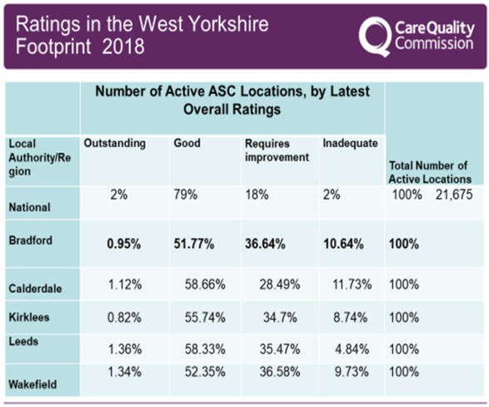
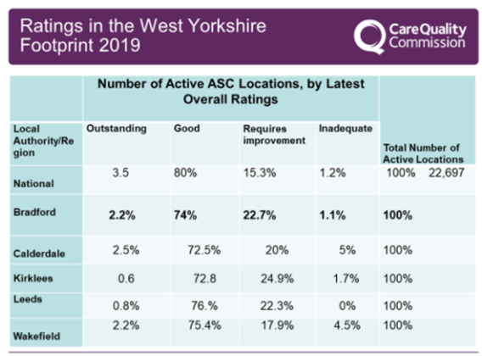
Partners Key Achievements In 2018-2019
Ratings map illustrates how Bradford has faired in comparison to other Local Authorities and against the national picture .
This illustrates the context of where we have found concerns with providers – of those rated requires improvement and inadequate
in Bradford (correct as of April 2019) a great deal of work has been undertaken in partnership with colleagues to ensure that people are appropriately safeguarded from the risks of abuse. Significant improvements have been made even in the last year in the ratings of the services which CQC have inspected. This is indicative of an improvement both in standards of care to protect people from harm but also of the knowledge of providers and staff about their safeguarding responsibilities.
It is extremely significant that inadequate services have fallen from 10.64% in 2018 to 1.1% in 2019. Services rated good have also increased significantly by 23% over the reporting period

Slide 27
Partners Key Achievements In 2018-2019
Bradford Adult Social Care
The local authority has made a significant investment in the safeguarding service in Bradford. There are dedicated social workers that work with the Multi agency Safeguarding Hub (MaSH) so that an immediate multi-agency response can be initiated where required.
Other key achievements include: Documented outcome satisfaction from service users, system development, internal audit tool created and there has been significant recruitment to the safeguarding service.
There is also a new suite of documentation with data collection fields to inform business intelligence dashboards and monitor KPI’s providing assurance to the BSAB.
Next Steps: Launch of the new policy and procedures in Jan 2020, launch of new recording systems and process, launch of a new suite of documentation across ASC, launch of new personalised safeguarding plan and MSP evaluations, launch of new whole service protocol and continue performance monitoring and audits.
West Yorkshire Police
Bradford Police continue to work alongside colleagues from the Local Authority and with other partners to ensure that relevant information about adults who may be at risk is shared effectively.
This year has seen them conduct more joint visits with other professionals to improve their support to vulnerable adults and they have been undertaking more work in care settings.
West Yorkshire Police received a rating of ‘Outstanding’ for its compliance with National Crime Recording Standards; what this means is that as a Force they are correctly identifying when a crime has been committed and recording it properly.
The Communications and Engagement sub-group is chaired a Bradford Police Superintendent and brings together work relevant to both the Safeguarding Adult’s and Children’s Boards as well as the Community Safety Partnership. The group will also be replicating the highly successful Safeguarding Champions Awards event held on June 2019.
Bradford District and Craven Clinical Commissioning Groups (CCGs)
CCGs have worked closely with partners to develop health and care partnership , as part of the ‘Happy, Healthy at Home’ plan for the future of health and care services in Bradford.
Named Doctors delivered face to face training to GPs and Practice Leads and the CCG has revised the training it provides for all its staff, making it more interactive and relevant. This includes PREVENT training about exploitation and violent extremism.
The CCGs use safeguarding and quality systems to monitor how well their providers are doing in protecting people from abuse, with regular assurance reports to CCG Quality Committee and Governing Bodies. The CCGs have also supported people with complex health needs to use Personal Health Budgets (PHBs) and take charge of arranging their own healthcare, around their individual circumstances.

Slide 28
Partners Key Achievements In 2018-2019
West Yorkshire Fire Service
Bradford District prevention manager led on the partnership approach to support people with care and support needs who hoard in Bradford. A time limited group reviewed regional policies and signed off an agreed policy for implementation in Bradford. This policy provides guidance to professionals within a multi-agency response framework.
The prevention manager acts a key link between the Board and the fire service, providing expert advice to matters of fire safety and risk to both the Board and the sub-groups.
The service has developed good working relationships with key partners and provides advice and leads on the multi-agency response to cases that involve high risk.
Next steps
The hoarding policy will be launched in July 2019 and included hoarding specialist advisors as key speakers to the workforce.
The panel of key representatives will meet on a six weekly basis to discuss referrals and provide updates to the SAB.
The panel will be evaluated on a regular basis to consider its effectiveness in reducing the associated risk of harm for adults with care and support needs who hoard
Airedale NHS Foundation Trust
Following the publication of the Intercollegiate document for Safeguarding Adults (August 2018) a training needs analysis was undertaken to identify what changes need to be implemented to ensure compliance with the new competency based training and requirements for minimum hours.
Safeguarding adults training forms part of mandatory training for all staff, clinical and non-clinical, including volunteers and non-executives.
Safeguarding training compliance for this review period is at 95% and this is under continuous review.
Following the training needs analysis, work commenced on how to implement the 4 levels of training to ensure the staff receive the most appropriate training commensurate with their role and to ensure compliance with competency requirements. This work is on-going in this current period
Mandatory training on the Mental Capacity Act is 92.2% compliant.
The Trust undertook an audit into mental capacity and best interest decision assessments to establish any aspects of good practice and areas for further development.
The audit was completed in February 2019 and results indicate that from 40 sets of patient notes, there was 100% compliance in a mental capacity assessment being completed.
Where the assessment indicated the person lacked capacity, best interest decisions were then completed in 67% of cases.
This picture is fairly consistent where mental capacity assessments are completed effectively but further work is needed with best interest decisions. This work includes more training but also more guidance on completion of the appropriate form rather than documentation in the patient’s medical notes.
Work is this period has remained on going with regards to making safeguarding personal across the Trust, staff work to closely with people if concerns are raised to ensure they are able to direct the process and their wishes and views are central to any actions taken
Next Steps: Develop a ‘making safeguarding personal’ template so that a consistent approach is taken in response to concerns being raised.
Consider the use of a safeguarding questions template across the partnership with inclusion of questions to inform practice development
Bradford Council Housing Services
Frontline staff in the Outreach Team provide support to vulnerable homeless households) and the Housing Standards team respond to issues of disrepair and health and safety in people’s homes). Housing Standards team have helped develop and launch the new multi-agency Hoarding Framework, and coordinate the Hoarding Panel. The Housing Options team see around 700 people each year who are suffering domestic abuse, and offer them housing advice, assistance or homelessness support.
Next Steps: Finalise and launch a new Homelessness and Rough Sleeping Strategy for the district, incorporating commitments to provide support for vulnerable people at risk of homelessness or rough sleeping.
Roll out further safeguarding training, including refreshers, across all frontline teams within Housing
Review and update the Housing Options Domestic Abuse rehousing protocol, ensuring safeguarding issues are at the forefront of this
Assist the SAB in developing a procedure for undertaking SARs for any rough sleeper deaths

Slide 29
Partners Key Achievements In 2018-2019
National Probation Service
Partnership work has continued including NPS taking a lead role in chairing the local statutory Multi Agency Public Protection Arrangements (MAPPA). The multi-agency approach ensures that in addition to risk of harm management, where offenders care and support needs an holistic approach is taken.
NPS also continues to work closely with partners when adults with care and support needs are identified when leaving prison, this work is normally in collaboration with adult social care, housing, health and mental health services.
Work has commenced to set up a system so that NPS has data regarding safeguarding referrals raised and will ensure any person-centred outcomes are identified and monitored to establish if this is achieved.
Adult safeguarding is mandatory training across the probation service
Annual Service User satisfaction surveys are undertaken via a national probation survey and a continued improvement is noted. This year 87% of respondents were satisfied with the service they received; 95 % felt they were treated with respect and 88 % felt they were treated as an individual.
A more personalised approach is being taken when working with offenders including separate male and female service user groups whose members provide suggestions for service improvements.
Next steps.
A new My learning database has been introduced to capture training data as part of management reports
An Offender Housing Board has been set up under CSP arrangements to help comply with the national homeless strategy to reduce homelessness and rough sleeping and ensure the principles of prevention, intervention and recovery are followed and offenders settled on release from prison.
Work has also started on reviewing the criteria for vulnerable people, to ensure a more consistent approach is taken; individual vulnerabilities highlighted including the risk of self-harm and support targeted around these needs.
Some further work is needed to ensure that where information is provided from the service that it in easily accessible formats
Bradford District Care NHS Foundation Trust
The BDCFT Safeguarding Adults policy is in the process of update and will be in line with and reference the revised Multi Agency Safeguarding Adult’s policy and procedures. These procedures are referenced within the trusts safeguarding adult training offer.
The trust is committed to working to promote SAB priorities.
•BDCFT safeguarding team are a staff facing support and advice service offering safeguarding guidance to all staff. The 6 principles of safeguarding adults and the understanding of making safeguarding personal is included within this support and advice. This includes seeking the views and wishes of the service user and promoting their outcome as central to the concern.
•The Trust works in partnership with other agencies proactively and reactively in relation to Safeguarding adults and is an active partner on all the subgroups.
Bradford Teaching Hospitals NHS Foundation Trust Independent Sector
The chief nurse is the SAB’s deputy chair, and delivery group chair and the named safeguarding nurse is the Safeguarding Adults Review group chair
Annual audits are undertaken to ensure compliance with the safeguarding procedures and the Mental Capacity Act 2005
The safeguarding team provides support advice and guidance to staff across the hospital.. When safeguarding concerns are raised the safeguarding team ensure that the person is spoken with and that their wishes and views are taken into account for any actions taken
Concerns regarding the quality of submissions are identified and addressed by the Safeguarding team. Themes are fed back through the safeguarding adult’s subgroup. The Safeguarding team are sighted on datix reports with a Safeguarding element to ensure necessary actions are undertaken

Slide 30
Future and Conclusion
The BSAB continue to recognise the changing environment both locally and nationally around Safeguarding. We will continue to progress collaborative work with the Children’s Safeguarding and Community Safety partnership around complex and contextual safeguarding including children transitioning into adults.
We will also work collectively in increasing our efforts to effectively communicate with professionals, communities and carers and work has commenced on a new single website that will provide valuable information and advice (www.safebradford.co.uk ).
Partners will start to consider the changes required to effectively embed the new Joint Multi-Agency Safeguarding Policy and Procedures for West Yorkshire, North Yorkshire and York.
The BSAB also recognises the changes that the Mental Capacity (Amendment) Act 2019 will bring, with the Deprivation of Liberty Safeguards (DoLS) scheme being replaced by the Liberty Protection Safeguards (LPS). Further work will be required to understand the impact on partners across Bradford.
All partners across the Bradford District continue to learn from Serious Case Reviews, Domestic Homicide Reviews and Safeguarding Adult Reviews. Learning from each is often transferable across the Childrens Safeguarding arena, the Community Safety Partnership and also the BSAB. Not only we will learn from local reviews but also from national reviews. We will build learning into our training, into our audits, policies and procedures and communicate learning through out established communication channels. Together these form the learning and improvement framework that brings together the work of the sub-groups.
The BSAB will look at increasing the collaborative work with the Health and Wellbeing Board and in particular around :
Transitional work in particular for complex safeguarding cases where the person becomes non-statutory in relation to adult safeguarding
Look at the extent of social isolation within the District and consider a whole system approach considering national best practice models.
Reassurance that there are identifiable pathways in place for young people with physical and mental health and those with learning disabilities transition into adulthood.

Slide 31
The Safer Bradford website offers information and advice https://www.saferbradford.co.uk/adults/
What should I do if I think I am being abused or that someone else is being abused?
If you have been told about or notice abuse or neglect:
Ensure the immediate safety and welfare of the adult and any other person at risk
If urgent attention is needed for health or safety dial 999 emergencies
If a crime needs to be reported call the police on 101 or you can call Crimestoppers on 0800 555 111
Preserve any evidence
Accurately record the incident, any action or decisions. Make sure you sign it and add the date and time.
Bradford Council’s Multi-Agency Safeguarding Hub (MASH) is the single point of contact to report safeguarding concerns. The MASH operates in partnership with West Yorkshire Metropolitan Police.
Please note that Adult Safeguarding concerns reported to the MASH are screened by both the Local Authority and Police.
You can contact the MASH team through our online form or by telephone on 01274 431077.

Slide 32
Abbreviation Matrix
This matrix of abbreviations has been created to provide clarity and useful links for all.
You can see the full list here: https://www.local.gov. uk/sites/default/files/documents/
Example
Need explanation of S42
Bradford Safeguarding Adults Board Abbreviation Matrix
Abbreviation | Name | Type | Description | Useful Link/Documents
ADASS | Association of Directors of Adult Social Care | Association | The association aims to further the interests of people in need of social care by promoting high standards of social care services and influencing the development of social care legislation and policy. | https://www.adass.org.uk/resources-policy-page
ASC | Adults Social Care | Service | Adult social care refers to a system of support designed to maintain and promote the independence and well-being of disabled and older people, and informal carers. | https://www.bradford.gov.uk/adult-social-care/care-and-support-from-us/new-to-adult-social-care/
BDCFT | Bradford District Care NHS Foundation Trust | Trust | Bradford District Care NHS Foundation Trust provides mental health, dentistry, community health and specialist learning disability services in Bradford, Keighley, Likely and Craven in Yorkshire, England. It achieved Foundation trust status in May 2015 | https://www.bdct.nhs.uk/
BIA | Best Interest Assessor | Person/Role | The lynchpin on which the entire edifice of DoLS rests, they have a range of duties that fall to them within the operation of the Safeguards. Best interests assessors are often the main assessors, though a mental health assessor may also assess capacity | https://www.gov.uk/government/publications/best-interests-assessor-list-of-organisations-providing-training

